Slide 1

Heap Sort: Searching and Sorting
Data Structure | Searching and Sorting
Course: Data Structure | Chapter: Searching and Sorting | Program: Bachelor of Engineering
DISCOVER · LEARN · EMPOWER
Notes:
Welcome everyone to today's lecture on Heap Sort. We are focusing on Unit-3, specifically the Searching and Sorting chapter. This topic is crucial for understanding efficient sorting algorithms in engineering applications. Remember our motto: Discover. Learn. Empower.

Slide 2
Course Outcomes
SLIDE 2 / 14
Course Outcome
CO | BT LEVEL | DESCRIPTION
CO1 | BT1 | Understand and apply basic data structures, algorithms, complexity analysis, ADTs, arrays and linked lists.
CO2 | BT2 | Apply and implement stacks and queues in problem-solving.
CO3 | BT3 | Analyse and apply searching, sorting, and hashing techniques.
CO4 | BT4 | Construct and apply tree structures and traversal techniques.
CO5 | BT5 | Represent and solve graph problems using DFS, BFS, and graph algorithms.
Chandigarh University
2 / 14
Notes:
Today's lecture directly addresses CO4 by applying tree structures to sorting. We will see how a binary heap is a specialized tree structure used for efficient sorting. While CO5 focuses on graphs, the tree traversal concepts here build the foundation for those graph algorithms later.

Slide 3
Learning Objectives
SLIDE 3 / 14
Learning Outcomes
1
Analyze the fundamental principles of the Heap Sort algorithm.
2
Construct a max-heap from an unsorted array of integers.
3
Apply the heapify process to sort elements in ascending order.
4
Evaluate the time complexity and space efficiency of the method.
5
Compare Heap Sort performance against other sorting techniques.
Chandigarh University
3 / 14
Notes:
By the end of this session, you will be able to analyze how Heap Sort works. You will learn to construct a max-heap and apply the heapify process step-by-step. We will also evaluate why this algorithm is efficient for large datasets.

Slide 4
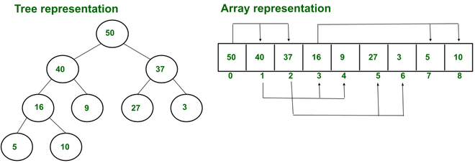
Lecture
SLIDE 4 / 14
What is Heap Sort?
1
Heap Sort is a comparison-based sorting algorithm using a binary heap data structure.
2
It utilizes the properties of a complete binary tree to organize elements efficiently.
3
The algorithm works by first building a heap and then repeatedly extracting the root.
4
It is an in-place sorting algorithm requiring only constant extra space O(1).
5
The time complexity is O(n log n) in all cases: best, average, and worst.
Difference between Heaps and Sorted Array - GeeksforGeeks
Chandigarh University
4 / 14
Notes:
Heap Sort is unique because it uses a tree structure to sort data without needing extra memory. Unlike Quick Sort, it guarantees O(n log n) performance even in the worst case. Think of it as organizing a messy pile of books by size using a specific stacking rule.

Slide 5
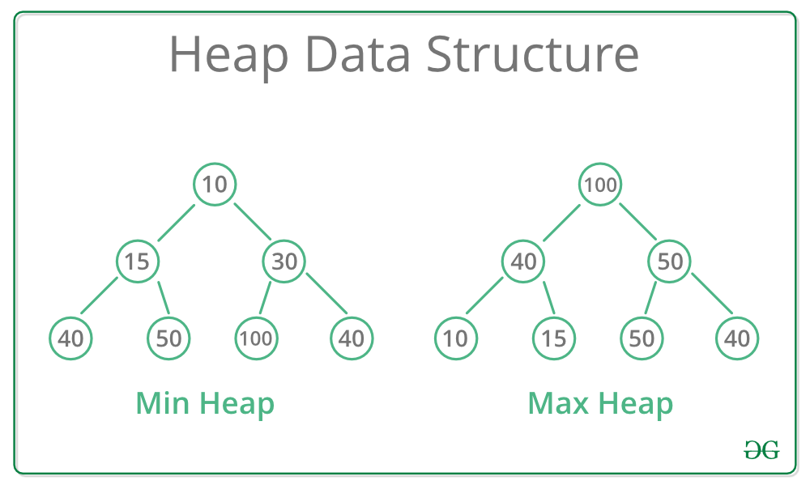
Lecture
SLIDE 5 / 14
Binary Heap Properties
1
A binary heap is a complete binary tree where all levels are fully filled except possibly the last.
2
In a Max-Heap, every parent node is greater than or equal to its children nodes.
3
In a Min-Heap, every parent node is less than or equal to its children nodes.
4
The root of a Max-Heap always contains the maximum element in the entire tree.
5
Array indexing maps perfectly to tree nodes: parent at i, children at 2i+1 and 2i+2.
Source: media.geeksforgeeks.org
Chandigarh University
5 / 14
Notes:
The key to Heap Sort is the Max-Heap property where the largest element is always at the root. This allows us to easily find the maximum value without scanning the whole array. Remember the array indexing rule: children of index i are at 2i+1 and 2i+2.

Slide 6
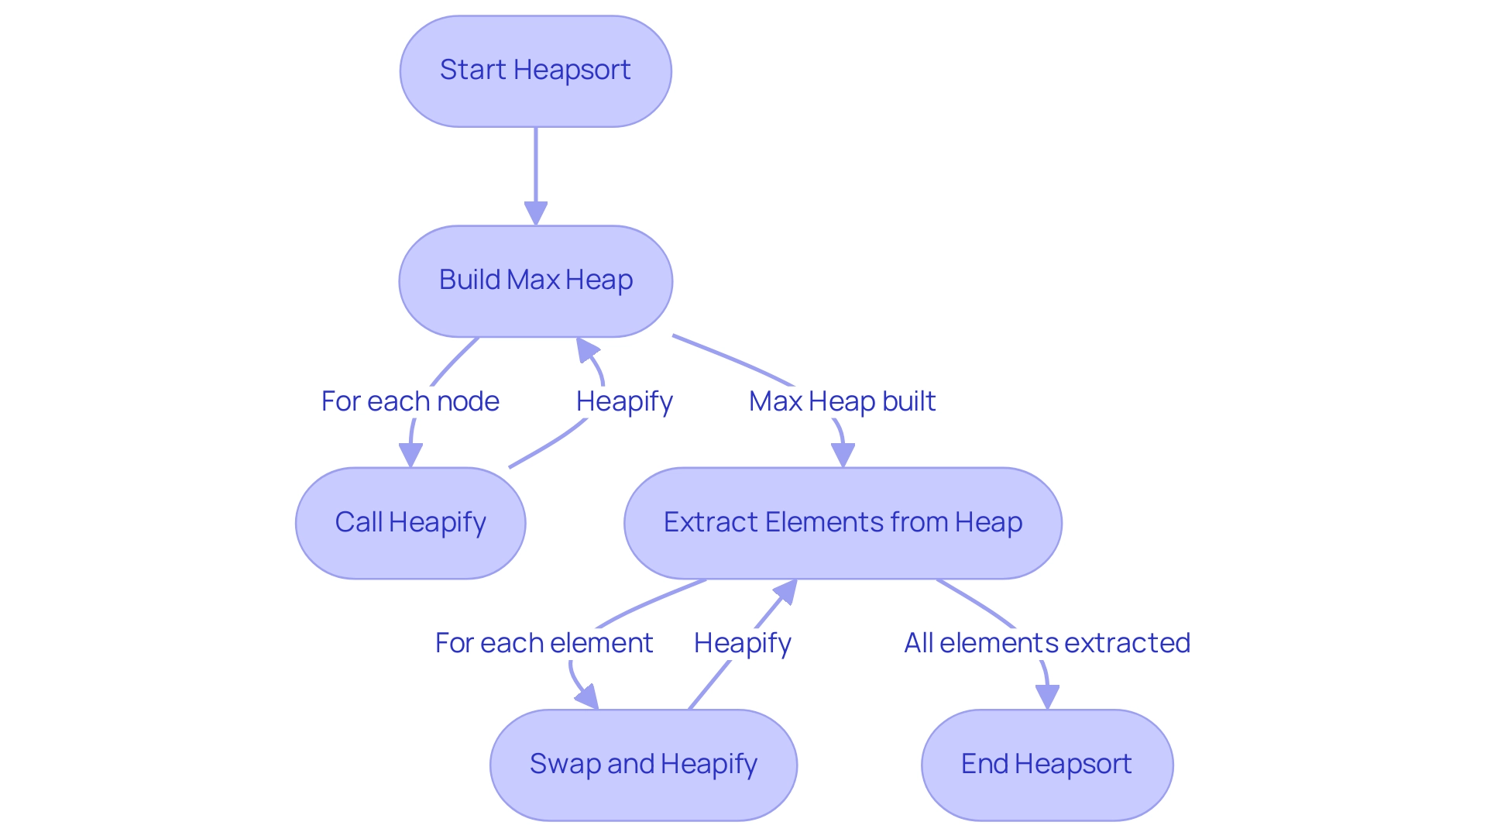
Lecture
SLIDE 6 / 14
The Heapify Process
1
Heapify is the recursive procedure that ensures the heap property is maintained for a subtree.
2
It compares the root with its children and swaps if the root is smaller than a child.
3
The process continues down the tree until the node is larger than both its children.
4
This operation runs in O(log n) time because the height of the tree is logarithmic.
5
Building a heap requires calling Heapify on all non-leaf nodes starting from the last one.
Source: cdn.prod.website-files.com
Chandigarh University
6 / 14
Notes:
Heapify is the engine of this algorithm. It ensures that if a node violates the heap property, it moves down until the structure is valid again. Imagine a heavy ball sinking through a fluid until it hits the bottom; that is how the largest element bubbles up or sinks down.

Slide 7
Lecture
SLIDE 7 / 14
Building the Max-Heap
1
Start by treating the entire array as a binary tree structure.
2
Identify the last non-leaf node at index floor(n/2) - 1.
3
Apply the Heapify function to each node moving backwards to the root.
4
This bottom-up approach ensures that subtrees are valid before processing their parents.
5
After this phase, the largest element is guaranteed to be at the root index 0.
Chandigarh University
7 / 14
Notes:
We build the heap from the bottom up, starting with the last non-leaf node. This is efficient because leaf nodes are already valid heaps of size one. By the time we reach the root, the entire array satisfies the Max-Heap property.

Slide 8
Lecture
SLIDE 8 / 14
Sorting Phase Logic
1
Swap the root element (maximum) with the last element of the current heap.
2
Reduce the heap size by one to exclude the sorted element from further processing.
3
Call Heapify on the new root to restore the Max-Heap property for the remaining elements.
4
Repeat the swap and heapify steps until the heap size reduces to one.
5
The array becomes sorted in ascending order after all elements are moved to the end.
Chandigarh University
8 / 14
Notes:
Once the heap is built, we extract the maximum element by swapping it with the end. We then shrink the heap and fix the structure. This repeats until the entire array is sorted. It is like peeling an onion layer by layer.

Slide 9
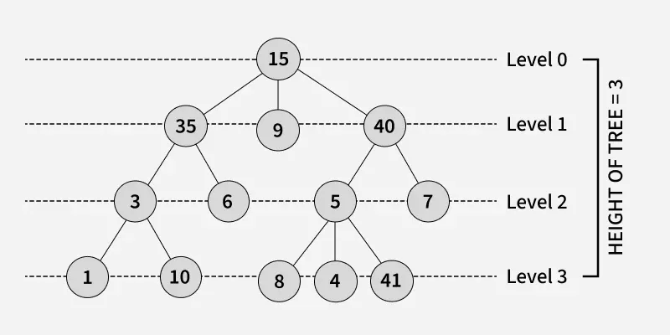
Worked Example
SLIDE 9 / 14
Initial Array
CONSIDER THE UNSORTED ARRAY
[4, 10, 3, 5, 1].
MAP THESE VALUES TO A BINARY TREE
Root is 4, children are 10 and 3.
• The last non-leaf node is at index 1 (value 10) in a 0-indexed array.
• We start the heapify process from index 1 and move up to index 0.
• The goal is to transform this into a valid Max-Heap structure.
Source: media.geeksforgeeks.org
Chandigarh University
9 / 14
Notes:
Let's look at a concrete example with the array [4, 10, 3, 5, 1]. We visualize this as a tree where 4 is the root. We need to check if the heap property holds. Currently, 10 is greater than 4, so we must swap them.

Slide 10

Worked Example
SLIDE 10 / 14
Building Heap
1
Swap 4 and 10: Array becomes [10, 4, 3, 5, 1].
2
Check node 4 (index 1): It has children 5 and 1.
3
Since 5 is greater than 4, swap 4 and 5.
4
Array becomes [10, 5, 3, 4, 1].
5
Now check the root 10: It is greater than 5 and 3, so it is valid.
Source: www.slideteam.net
Chandigarh University
10 / 14
Notes:
After swapping 4 and 10, we check the next node. Node 4 has children 5 and 1. Since 5 is larger, we swap them. Now the array is [10, 5, 3, 4, 1]. The root 10 is the largest, so the Max-Heap is built.

Slide 11
Worked Example
SLIDE 11 / 14
Sorting Steps
REPEAT UNTIL THE ARRAY IS FULLY SORTED
[1, 3, 4, 5, 10].
• Swap root 10 with last element 1: Array becomes [1, 5, 3, 4, 10].
• Heap size reduces to 4. Heapify the root 1.
• Swap 1 with 5: Array becomes [5, 1, 3, 4, 10].
• Swap 1 with 4: Array becomes [5, 4, 3, 1, 10].
Chandigarh University
11 / 14
Notes:
Now we sort. We swap 10 to the end. The heap is now [1, 5, 3, 4]. We heapify the root 1. It swaps with 5, then with 4. The largest remaining element 5 moves to the root. We repeat this until the array is sorted.

Slide 12
Lecture
SLIDE 12 / 14
Time Complexity Analysis
GOVERNING EQUATION
Total time complexity is O(n) + O(n log n) = O(n log n)
1
Building the heap takes O(n) time using the bottom-up approach.
2
Extracting each of the n elements requires O(log n) heapify operations.
3
The algorithm performs consistently regardless of the initial order of input data.
4
Space complexity is O(1) as it sorts the array in place without recursion stack.
Chandigarh University
12 / 14
Notes:
The total time is dominated by the extraction phase. Building the heap is surprisingly linear, O(n). Extracting n elements takes n × log n. This makes it very reliable for large datasets where worst-case performance matters.

Slide 13
Lecture
SLIDE 13 / 14
Key Takeaways
THE ALGORITHM CONSISTS OF TWO PHASES
building the heap and extracting elements.
• Heap Sort uses a binary heap to achieve O(n log n) sorting efficiency.
• It is an in-place algorithm with constant space complexity O(1).
• Unlike Quick Sort, it guarantees O(n log n) performance in all cases.
• The heapify process is critical for maintaining the tree structure during sorting.
Chandigarh University
13 / 14
Notes:
To summarize, Heap Sort is a robust sorting method that guarantees efficiency. It builds a heap and then extracts elements one by one. Remember, it is in-place and stable in terms of time complexity, making it ideal for systems with memory constraints.

Slide 14
Lecture
SLIDE 14 / 14
References
DATA STRUCTURES
A Pseudocode Approach with C — Gilberg, Forouzan
• Data Structures — Lipschutz
• Data Structure Using C — AK Sharma
• C and Data structure — P. S. Deshpandey
Chandigarh University
14 / 14
Notes:
For further reading, please refer to the standard textbooks listed here. Gilberg and Forouzan provide excellent pseudocode approaches. Lipschutz and Sharma offer deep insights into C implementations. Deshpandey is also a great resource for practical examples.

